Slide 1

FINE TUNING: FALCON-7B LLM (EVALUATION METRICS)
1
PRASUN DUTTA

Slide 2
EVALUATION METRICS
2
Our primary aim is to evaluate the fine-tuned LLM’s ability to generate a generalized output as closely as possible to the reference dataset (used to fine-tune the model).
Accuracy in generating a desired answer is a predominant focus in LLM evaluations. However, issues such as over-fitting and ignoring detrimental aspects like unfairness or hallucination render accuracy an imperfect evaluation metric.
Hallucination aspect has gained researchers’ attention recently which involves generating false or misleading information by well-trained LLMs, often due to biases in training data, leading to overconfident and inaccurate outputs. This overconfidence is closely linked to an overreliance on accuracy-oriented training. To address these issues, it’s crucial to understand the key considerations and criteria in LLM evaluation [1].

Slide 3
EVALUATION METRICS
3
I. BLEU: Bilingual Evaluation Understudy
It is a metric commonly used in a variety of NLP tasks to evaluate the quality of candidate texts [2].
It quantifies the similarity between the candidate text and reference text as a score between 0 and 1.
A score of 0 means there is no overlap with the ground truth text, and 1 meaning there is a perfect overlap. So, in our case the model generated answers will be treated as candidate text and the response texts inside trec-cast dataset will be treated as reference text to calculate our model’s BLEU score.

Slide 4
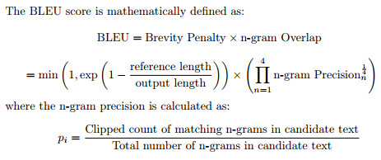
EVALUATION METRICS
4
I. BLEU: Bilingual Evaluation Understudy
The BLEU score consists of two components — the Brevity Penalty and the n-gram Overlap [2]:
The n-gram Overlap counts the number of 1-grams, 2-grams, 3-grams, and 4-grams of the output text that match the 1-, ..., 4-grams in the reference text — which is analogous to a precision score for the text. The 1-gram precision ensures that the correct vocabulary is used, whereas the 4-gram precision ensures that the candidate text is coherent.
The Brevity Penalty is applied to penalize the score for generating sentences that are less in length than the reference text. This is due to the fact that the n-gram Overlap precision tends to give disproportionately high values to candidate texts that are very short in length, but mostly contain n-grams in the reference text.

Slide 5
EVALUATION METRICS
5
II. ROUGE: Recall-Oriented Understudy for Gisting Evaluation
It is a metric used for evaluating text generation models (summarization or Q&A) [3].
ROUGE is based on measuring the overlap between the model prediction and the human-produced reference.
ROUGE-N refers to the direct n-gram overlaps between the candidate (prediction) and the reference. ROUGE is the F1 score from the n-gram precision and recall.
Precision in the context of ROUGE reflects the fraction of the n-grams in the prediction that are also in the reference, and the Recall is the fraction of reference n-grams that also appear in the model prediction.
The ROUGE scores lie in the [0,1] range, with a score of 1 indicating the total match between the reference and the prediction.

Slide 6
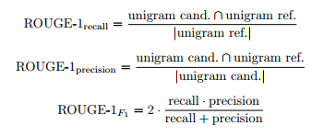
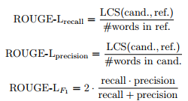
EVALUATION METRICS
6
II. ROUGE: Recall-Oriented Understudy for Gisting Evaluation
We calculate the ROUGE-1 score as shown below:
For ROUGE-2, the core formulas are the same as for ROUGE-1, with the only difference in using bigrams instead of unigrams.
For ROUGE-L, we will calculate the longest common subsequence between the candidate and the reference:

Slide 7
EVALUATION METRICS
7
III. BERTScore
BertScore is a method used to measure the quality of text summarization. This method measures how similar the text summary is to the original text [4].
BertScore addresses two common issues that n-gram-based metrics often encounter [5]:
n-gram models tend to incorrectly match paraphrases because semantically accurate expressions may differ from the surface form of the reference text, which can lead to incorrect performance estimation. BertScore, on the other hand, performs similarity calculations using contextualized token embeddings shown to be effective for entailment detection.
n-gram models cannot capture long-range dependencies and penalize semantically significant reordering.

Slide 8
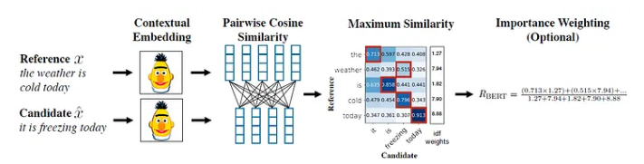
EVALUATION METRICS
8
III. BERTScore
Fig 1: BERTScore Architecture [4]
Steps involved in calculation of BERTScore :
Contextual Embeddings
Cosine Similarity
Token Matching for Precision and Recall
Importance Weighting
Baseline Rescaling

Slide 9
EVALUATION METRICS
9
IV. MoverScore
It also uses contextualized embeddings to compute the distance between tokens in the generated output and reference. But unlike BERTScore, which is based on one-to-one matching (or “hard alignment”) of tokens, MoverScore allows for many-to-one matching (or “soft alignment”) [6].
MoverScore enables the mapping of semantically related words in one sequence to their counterparts in another sequence. It does this by solving a constrained optimization problem that finds the minimum effort to transform one text into another. The idea is to measure the distance that words would have to move to convert one sequence to another.

Slide 10
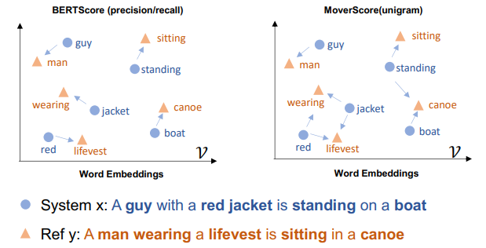
EVALUATION METRICS
10
IV. MoverScore
Fig 2: An illustration of MoverScore and BERTScore [6]

Slide 11
REFERENCES
12
[1] Hu, T., & Zhou, X. (2024). Unveiling LLM evaluation focused on metrics: challenges and solutions. arXiv.org. https://arxiv.org/abs/2404.09135
[2] Papineni, Kishore & Roukos, Salim & Ward, Todd & Zhu, Wei Jing. (2002). BLEU: a Method for Automatic Evaluation of Machine Translation. 10.3115/1073083.1073135.
[3] Lin, Chin-Yew. (2004). ROUGE: A Package for Automatic Evaluation of summaries. Proceedings of the ACL Workshop: Text Summarization Braches Out 2004.
[4] Zhang, T., Kishore, V., Wu, F., Weinberger, K. Q., & Artzi, Y. (2019, April 21). BERTScore: Evaluating Text Generation with BERT. arXiv.org. https://arxiv.org/abs/1904.09675
[5] Özbolat, H. (2023, October 13). Text summarization: How to calculate BertScore - Hatice Özbolat - Medium. Medium. https://haticeozbolat17.medium.com/text-summarization-how-to-calculate-bertscore-771a51022964
[6] Zhao, W., Peyrard, M., Liu, F., Gao, Y., Meyer, C. M., & Eger, S. (2019, September 5). MoverScore: Text Generation Evaluating with Contextualized Embeddings and Earth Mover Distance. arXiv.org. https://arxiv.org/abs/1909.02622

Slide 12
13
THANK YOU

